Slide 1
An Adaptive Query-Routing Framework for Optimizing Small Language Models
Resource-Constrained Environments & Data Privacy Solutions
DEGREE IN
Creative Computing and Artificial Intelligence
PRESENTED BY
José Ribeiro
Research Presentation
Based on: An Adaptive Query-Routing Framework for Optimizing Small Language Models
Notes:
good afternon thank you all coming Thank you president do juri professor -Andre Sabino And professor Chrysoula Zerva, for being here
im presenting my thesis “title“

Slide 2
Index
Methodology Overview
Summary & Future Work
Research Objectives
Problem Statement & Motivation
Related Work
Key Findings & Results
Broader Impact

Slide 3

Problem Statement & Motivation
Critical Challenges in Current LLM Deployment
High Computational Costs
High cost of specialized GPUs
Prohibitive for many SMEs
Expensive infrastructure
The Challenge
8B
Parameter SLMs
Accessible but limited accuracy
Data Privacy Constraints
Strict compliance needs (GDPR/CCPA)
Restrictions on cloud-based LLMs
On-premises solutions essential
vs
70B+
Parameter LLMs
High accuracy, prohibitive costs
Resource Limitations
Deployment on single-GPU workstations
Limited access to high-performance hardware
Practical deployment constraints
Core Dilemma
Organizations face high costs, strict privacy rules, and limited hardware.
Smaller models are accessible but often lack the required accuracy.
Performance Gap
SLMs (~8B params) suffer accuracy degradation
Trade-off between model size and quality
Need for efficiency without sacrificing performance
How can we boost SLM accuracy within tight resource and privacy constraints?

Slide 4

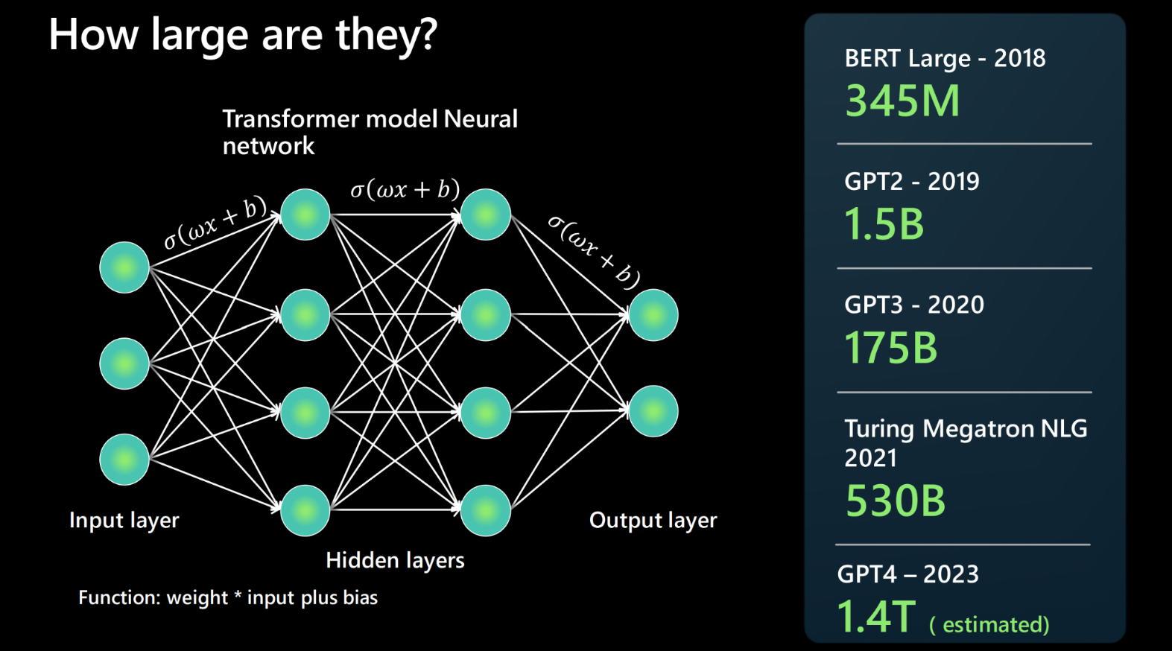
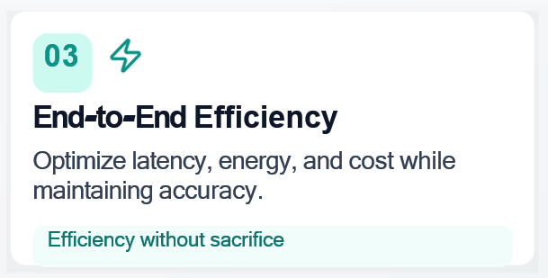
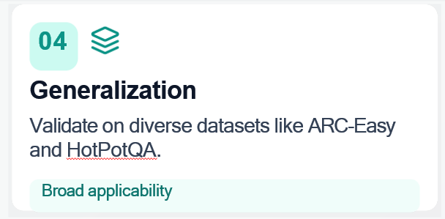
Research Objectives
Enabling Efficient SLM Deployment
Primary Goals
Design and validate an adaptive framework to optimize SLMs for real-world deployment.
01
02
03
Resource-Constrained Deployment
Deploy on-premises with strict resource, privacy, and single-GPU constraints.
Adaptive Query-Routing
Select between Direct Answer, CoT, and RAG based on the query.
End-to-End Efficiency
Optimize latency, energy, and cost while maintaining accuracy.
Practical, real-world applicability
Intelligent path selection
Efficiency without sacrifice
04
Generalization
Validate on diverse datasets like ARC-Easy and HotPotQA.
Broad applicability

Slide 5
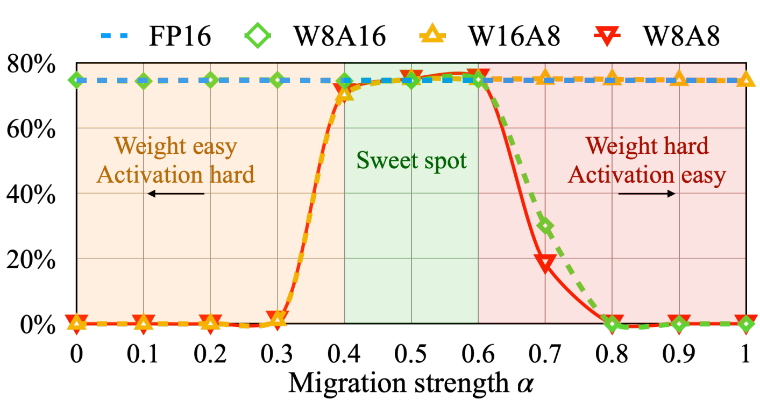
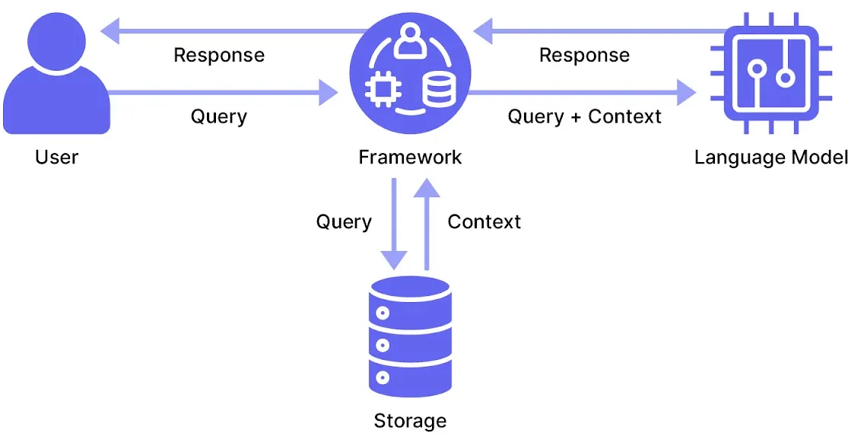
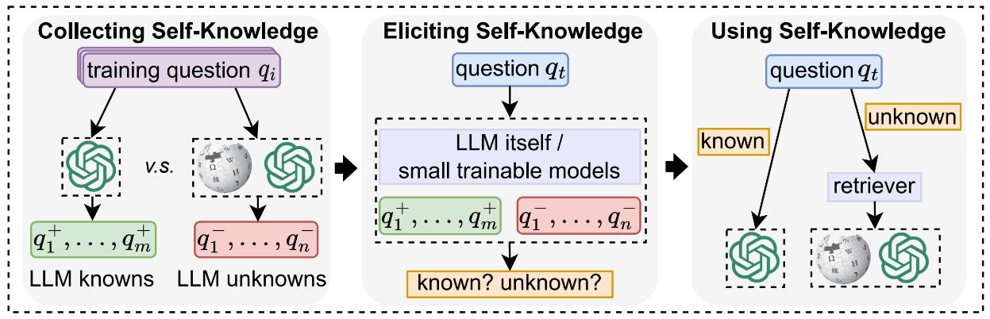
Related Work
Foundations & Efficiency Techniques
Research Foundations
LLM Evolution:
From RNN/LSTM limitations to Transformer revolution with self-attention mechanisms
Quantization:
From full-precision models to efficient low-bit inference for scalable deployment
Modern IR:
Shift from term-based to neural retrieval with integrated IR stack
Dataset Benchmark:
From static test sets to dynamic, diverse, and capability-driven evaluation of LLM performance
Figure 1: Retrieval-Augmented Generation (RAG)
Neural retrieval architecture integrating external knowledge bases for information-intensive queries
Figure 2: SmoothQuant
Mixed-precision quantization technique that migrates difficulty between activations and weights for efficient model compression
Figure 3: Self-Routing Architecture
Adaptive routing mechanisms for dynamic model selection and optimization

Slide 6
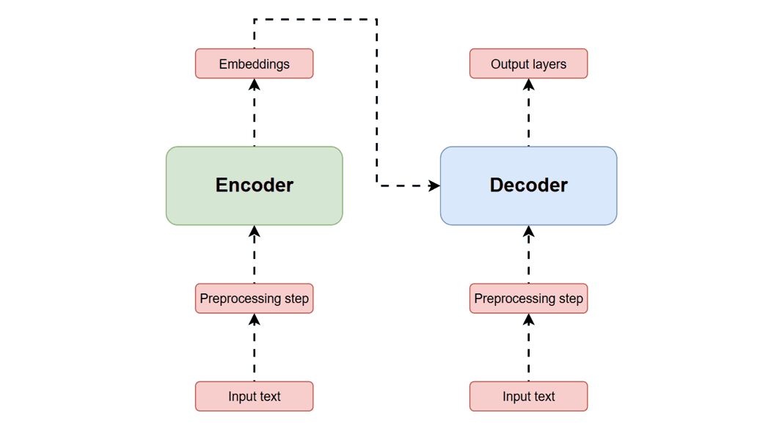
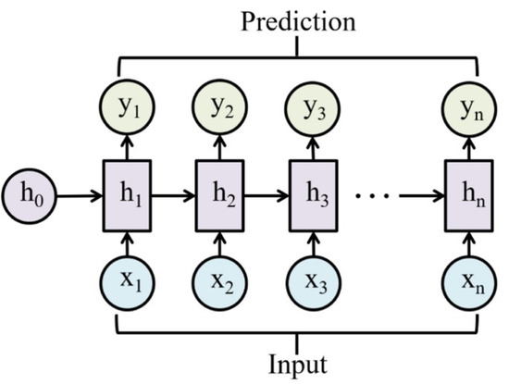
Transformers & Language Models
Foundational Architecture for Modern NLP
Self-Attention Mechanism
Enables global context understanding
O(1) parallel processing vs. O(n) for RNNs
Multi-Head Attention
Attends to information from different subspaces
Captures diverse linguistic features
Positional Encoding
Injects token position information via sinusoids:
PE(pos, 2i) = sin(pos / 10000^(2i/d_model))
Evolution to GPT & BERT
GPT: Decoder-only, auto-regressive.
BERT: Encoder-only, bidirectional.
Layer Type | Complexity per Layer | Sequential Ops | Max Path Length
Self-Attention | O(n^2 * d) | O(1) | O(1)
Recurrent | O(n * d^2) | O(n) | O(n)
Convolutional | O(k * n * d^2) | O(1) | O(log_k(n))

Slide 7
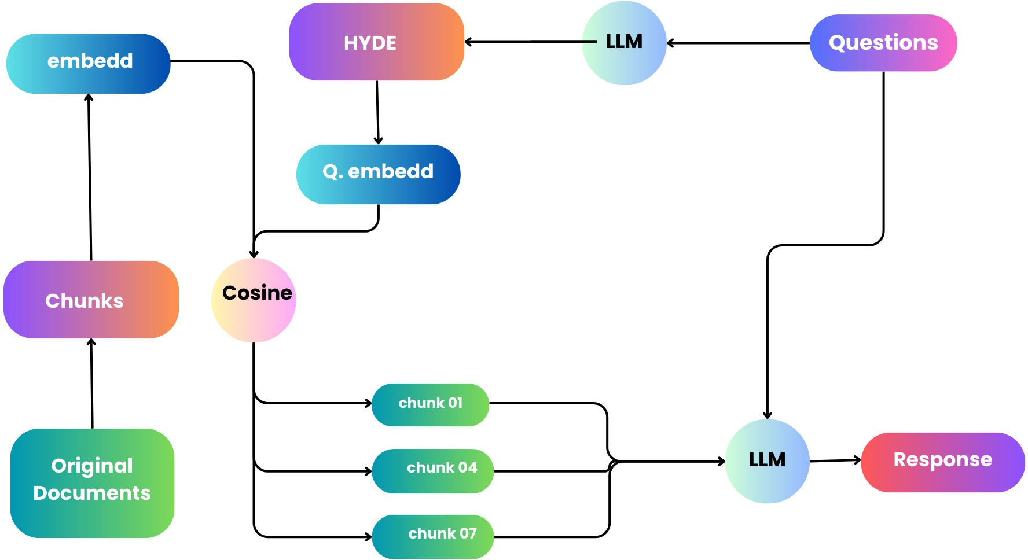
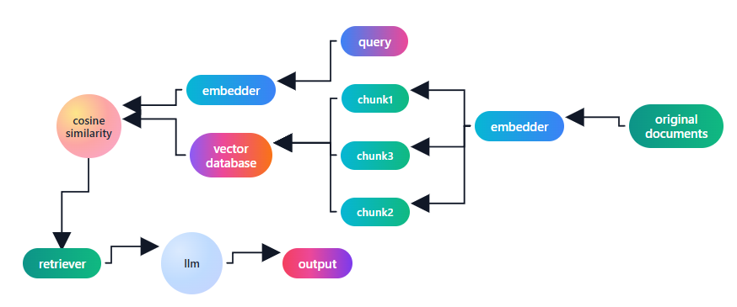
Information Retrieval
Integrating External Knowledge with Language Models
Hypothetical Document Embeddings (HyDE)
Concept: Generates a hypothetical document to improve retrieval accuracy.
Process:
LLM generates a hypothetical document.
Embed this hypothetical document.
Retrieve similar real documents.
RAG Framework
Definition: Combines retrieval and generation to ground responses in external knowledge.
Core Process: Query → Retrieve → Generate
Benefits:
Reduces hallucinations with factual data Enables dynamic knowledge updates
Effective for domain-specific tasks

Slide 8
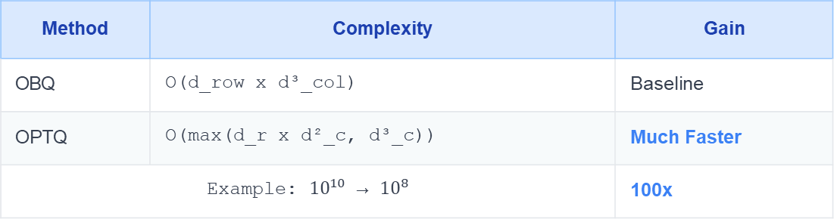
Quantization Techniques for LLMs
Reducing Computational and Memory Requirements
Overview
Quantization converts weights to lower precision (e.g., INT8/INT4) to reduce memory usage and accelerate computation.
Featured: OPTQ Algorithm
A Breakthrough in Extreme Quantization
Key Challenge: Balancing model size reduction with performance.
Key Achievement: Enables OPT-175B on a single A100 GPU.
Technical Innovations:
Arbitrary Order: Simultaneous multi-row processing.
Lazy Batch Updates: Groups updates across blocks.
Performance: Effective down to 2-bit precision.
Post-Training Quantization (PTQ)
Definition: Applied after model training, no retraining or data required.
Most common method due to its accessibility.
Methods: OPTQ, ZeroQuant-V2
Advanced Methods
Runtime Comparison
Method | Complexity | Gain
OBQ | O(d_row x d³_col) | Baseline
OPTQ | O(max(d_r x d²_c, d³_c)) | Much Faster
Example: ${10}^{10}$ → ${10}^{8}$ |  | 100x
Non-Uniform
Allocates more precision to important weight ranges.
Weight+Activation
Quantizes both weights and activations (e.g., SmoothQuant).
Impact: Makes extreme quantization practical for deploying large models on standard hardware.
Mixed Precision
Uses different bit-widths for different layers.
Quantization-Aware
Simulates quantization during training for adaptation.

Slide 9
Model Comparison and Benchmark Performance
Evaluation Across Standard NLP and Reasoning Tasks
Evaluation Benchmarks
Knowledge & Reasoning
MMLU, MMLU-Pro, BBH, MUSR
Question Answering
ARC, TruthfulQA, HotPotQA
Specialized Tasks
GPQA, GSM8K, IFEval
Commonsense Reasoning
HellaSwag, WinoGrande, PIQA
Key Benchmark Results
MMLU
Diverse, professional-level tasks. 8B models achieve 60-70%.
MMLU-Pro
Challenging version with 10 options per question to reduce guessing. Difficult version of the original MMLU.
ARC (AI2 Reasoning Challenge)
Grade-school science questions. 8B models achieve ~70% on easy.
HotPotQA
Multi-hop QA over multiple documents. Requires retrieval.
BBH (Big-Bench-Hard)
Complex reasoning tasks. CoT dramatically improves performance.
GPQA (Graduate-Level Q&A)
PhD-level, 'Google-proof' questions. SOTA models score 40-50%.
Key Insights for Deployment
🔍 Size vs. Perf: 8B quantized models achieve 70-80% of large model performance.
🚀 RAG Impact: Boosts knowledge-heavy tasks (e.g., ARC, HotPotQA) by 15-25%.
🎯 Optimization: Use CoT for reasoning and RAG for knowledge-intensive tasks.

Slide 10

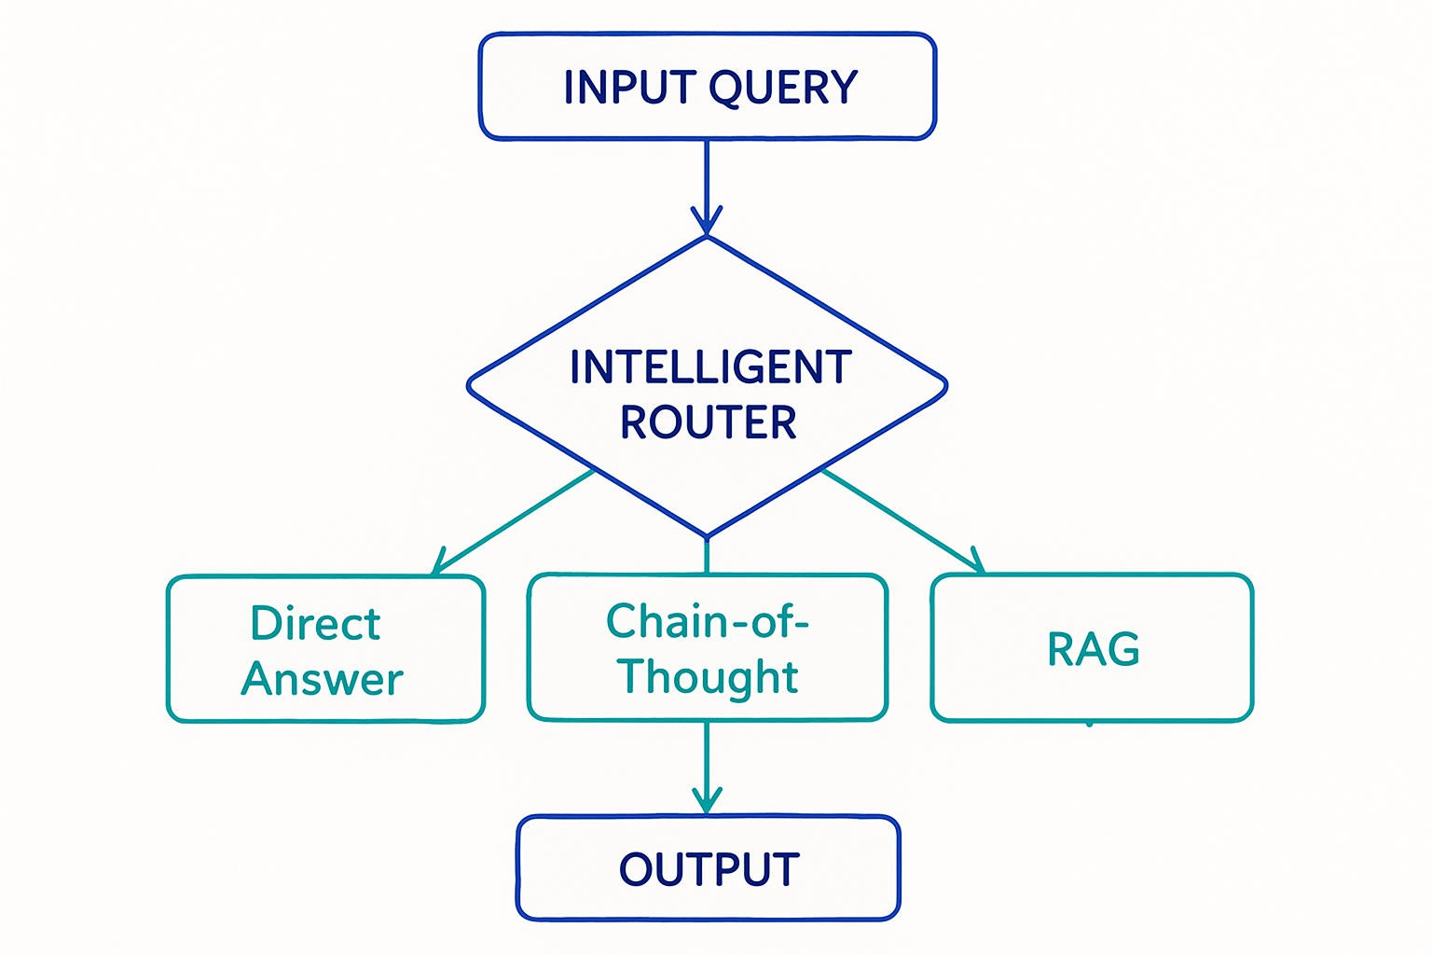
Methodology Overview
Adaptive Query-Routing Architecture
Core Innovation
A compact LLM and lightweight controller select the best processing strategy per query.
Right strategy for each query type
Path 1
Direct Answer (DA)
Quick responses for simple, known queries.
Path 2
Chain-of-Thought (CoT)
Step-by-step reasoning for complex problems.
Path 3
Retrieval-Augmented Generation (RAG)
Fetches external knowledge for informed answers.
Select the correct path with the amount of nonsense the model outputs
Format-Driven Heuristics
Initial rule-based routing
Profile-Based Classification
Learned query patterns
Notes:
Now moving into the methodology Overview where we take a look at the approach chosen to make the small model achieve closer to the big one

Slide 11
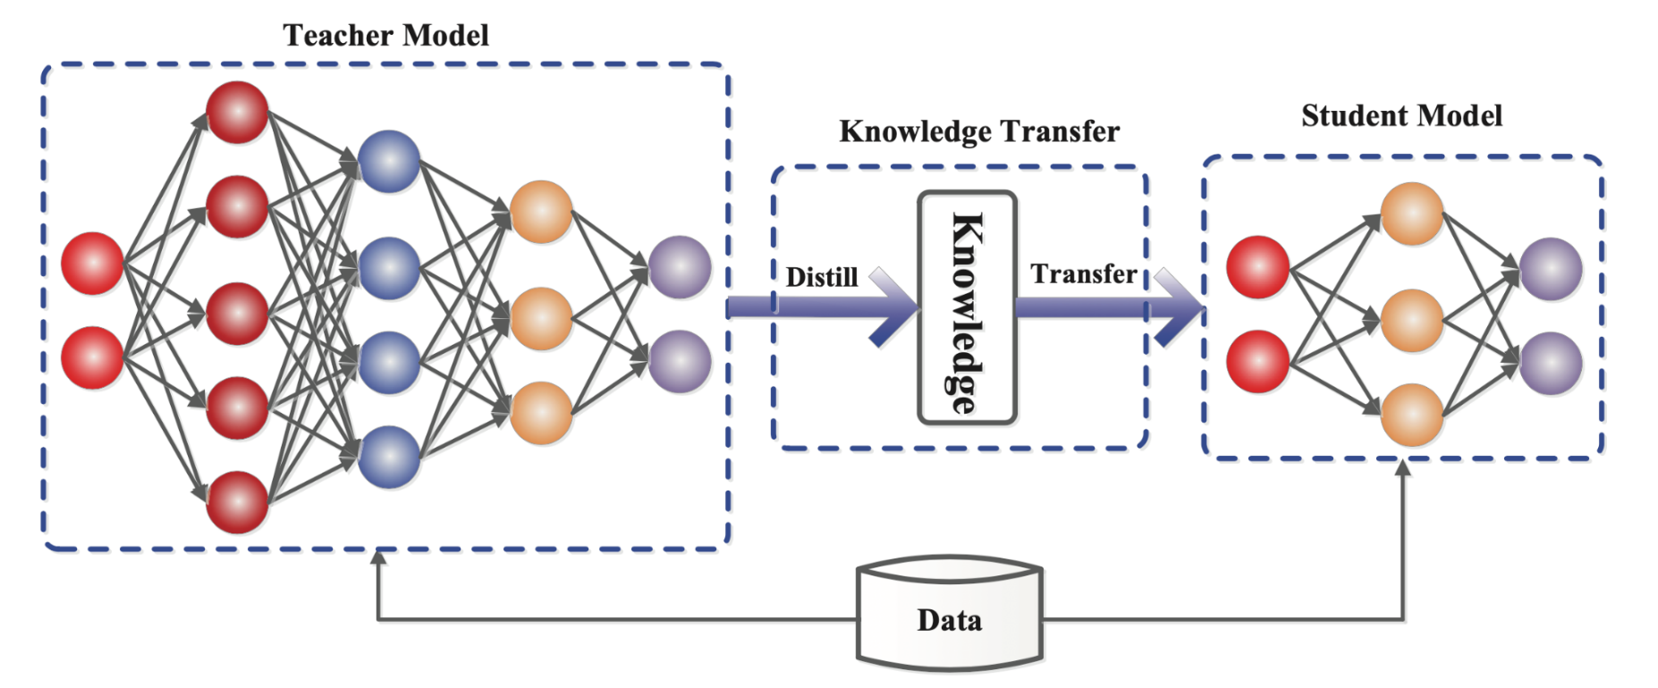
Model Architecture
Model Used
Student Model
8B Parameter LLM
LLAMA foundation
Open-source
Teacher Model
671B Parameter LLM Deepseek-ai
Open-source
Model Specifications
Base Model:
Llama-3.1-8B
Inference:
Single-GPU compatible
Model Specifications
Base Model:
DeepSeek-R1
Inference:
Datacenter worth of computing power required
Resulting Model
8B Parameter LLM
Distilled from R1
Open-source
Model Specifications
Base Model:
DeepSeek-R1-Distill-Llama-8B
Inference:
Single-GPU compatible
Notes:
One thing that was missing on the previous slide was the model since he is ultimately the one responsible for picking the path

Slide 12
Dataset Preparation
A Three-Stage Systematic Framework
Framework Overview
A hybrid approach integrating automated analysis with human-in-the- loop validation to ensure query quality.
1
Automated Preparation
Data ingestion and categorization
Split queries: retrieval vs. non-retrieval Prepare batches for clipboard instructions
Key Purpose: Ensures dataset integrity through multi-stage verification
Dataset Overview
Produces clear, answerable queries using ARC-Easy and HotPotQA.
Combines retrieval-based and step-by-step reasoning queries.
Tailored for systems that select optimal approaches.
Captures a broad spectrum of question types, encouraging flexible and adaptive problem-solving.
2
AI-Powered Triage
Green Flag: Clear query, correct ground truth. Passed.
⚠ Red Flag: Ambiguous or inconsistent. Sent for human review.
3
Human Verification
Validators review only Red Flag queries for maximum efficiency.
Verify LLM's Red Flag justification Remove or replace failed queries
Note: Generated dataset is suitable for models around 32B tokens or lower due to ARC-easy complexity.
Systematic Quality Assurance for Dataset Integrity
Notes:
To access if the model is good and if the system is working we need a dataset however

Slide 13
Power Data Collection
GPU and CPU Energy Measurement Methodology
GPU
Tool: nvidia-smi
Type: TBP (Total Board Power)
CPU
Tool: HWiNFO (proprietary) Type: CPU Package Power
Includes: GPU die, VRAM, and all supporting components.
Scope: CPU chip only (excludes VRMs, chipset, peripherals).
Rate: ~50ms (actual via NVML driver queries).
Rate: ~150ms (actual from CSV generated at end of run).
Integration: Power measurements are added directly to the final JSONL file.
Processing: A script applies the trapezoidal rule to approximate energy consumption from power data and adds it to the JSONL.
⚡ VRAM power is a significant factor for LLM inference.
JSONL Data Structure
Final structure comprising four main parts, finalized at different stages.
Query Info
Stage: Initial
Query text
Metadata & IDs
Ground Truth
Stage: Initial
Expected answer
Correct options
AI Prediction
Stage: Post-Inference
Model responses
Routing decisions
Performance
Stage: Post-Processing
GPU & CPU Power
Total Energy
Timestamps
System receives Parts 1-2
System adds Parts 3-4
Software-Based Energy Monitoring on Windows Systems
Notes:
What does a good ai research paper needs more data so I built a system capable of collecting both gpu and cpu

Slide 14
V4-V6: Core Framework Instructions inner works
These instructions introduce a structured decision-making system that determines whether a query requires external information (retrieval) or can be answered directly.
Its aim is to improve consistency, reduce errors, and ensure that each query is handled using the most appropriate reasoning pathway.
2
Profile Assignment
Queries are assigned to one of two profiles:
Profile 1 – Retrieval Required
Profile 2 – Direct Answer Sufficient
Core Objective: Maintain high-quality responses by enforcing a clear separation between retrieval-dependent tasks and knowledge-based reasoning.
3
Structured Output Format
“1-Yes” : Retrieval is needed.
Query Assessment
The system analyses the user’s query to detect whether it contains:
1- Specific data requirements.
2- Time-sensitive facts.
3- Non-famous people, places, or organizations
4- Request involving statistics, dates, or precise values
If any of these are present, the query is classified as retrieval-required.
⚠ ”2-No”: Retrieval is not needed.
1
4
Model specific
The expected model downfalls are used to understand which option would be more useful when retrieval is not required
CoT is used when the model still pays attention to the instruction and follows the instructions.
Straight answer is used when the model ignores the whole instruction provided.
Adaptive Query-Routing Framework for Optimizing Small Language Models
Notes:
With all that data the next step is running the whole system and that was done with instructions here is the main framework off instruction v4 to v6

Slide 15

Analysis V5: Accuracy-First Strategy Defaulting to Retrieval for Maximum Accuracy
Purpose
Achieve the best possible accuracy on the provided dataset
1- Decision Patterns
2- Profile 1 Triggers
Decision Rule
Specific & Non-Famous Entities
Precise Data (numbers, dates, statistics)
Comparative Judgments requiring evidence
Recent Events (very recent topics)
Primary goal: Choose the BEST fit profile
When in doubt → Default to retrieval (1-Yes)
"A slow but correct answer is always better than a fast but wrong one"
Safety-first approach: Any ambiguity → Choose '1-Yes'
Better to retrieve unnecessarily than miss required information

Slide 16
Analysis V6: Reducing Unnecessary Retrieval Efficiency-Driven: Retrieve Only When Necessary
Purpose
Achieve the best possible efficiency on the provided dataset
1- Decision Patterns
2- Profile 1 Triggers
Low-Fame Entities (if lacking confident knowledge)
Hard Data (not common trivia)
Recent Information (last 2 years: events, releases, news)
Document-Based Analysis (specific text comparisons)
Decision Rule
Primary goal: Reduce incorrect '1-Yes' classifications
Default assumption: Query is '2-No' (direct answer)
Requires explicit retrieval trigger - no caution-based defaults
Scrutinize for clear triggers - don't default to '1-Yes' out of caution
Explicit reason required for retrieval
3- Profile 2 Expansion
Now includes: globally famous entities, major historical events, well-established facts
Examples: "When did WWII end?", "Value of Pi?"

Slide 17

Optimizing Query Classification Iterative Prompt Refinement and Performance Analysis
Context
LLM performance linked to instruction clarity and quality
Classification Task
Retrieval | Step-by-step reasoning | Direct answer
Evaluation Metrics
Routing Accuracy Answer Accuracy
Approach
Six versions: simple prompt → structured framework
Efficiency
Early Iterations (V1-V3)
Advanced Iterations (V4-V6)
Key Insights
Instruction engineering provides high degree of control over LLM behavior
V1: Simple Baseline
Approach: Minimal instruction, binary classification
Results: 52.3% routing accuracy, 16.59% retrieval identification
Issue: Strong anti-retrieval bias, insufficient for smaller models
V4: Profile-Based Classification ⭐
Approach: Holistic classification matching queries to detailed profiles Results: 82.0% routing accuracy, 91.88% retrieval, 69.36% general knowledge
Impact: 95.27% answer accuracy (20.35pp better than baseline)
Breakthrough: Leveraged LLM's pattern-matching, introduced 'Recent Events'
Simple prompts insufficient for reliable routing in smaller models
Profile-based classification outperforms sequential checklists
V2: Aggressive Safety-First
Approach: Strong bias toward retrieval as default
Results: 66.7% routing accuracy, 98.22% retrieval, 26.07% general knowledge
Issue: Over-correction led to inefficient, redundant processing
Clear trade-off between accuracy and efficiency
V5: Guiding Principle
Approach: Added tie-breaker: "slow but correct > fast but wrong"
Results: 81.1% routing accuracy, 92.0% retrieval, 67.07% general knowledge
Philosophy: Accuracy-first principle with safety default
V5 optimal for reliability (accuracy-first systems)
V6 optimal for efficiency (speed-critical systems)
Conclusion
Instruction choice depends entirely on desired system behavior and priorities
V3: Balanced Criteria
Approach: Explicit categories with two-step reasoning
Results: ~98% retrieval accuracy, but general knowledge dropped to 21.27%
Issue: Sequential checklist approach remained problematic
V6: Efficiency-Focused ⚡
Approach: Non-retrieval as default unless clear trigger present Results: 72.6% routing accuracy, 58.77% retrieval, 90.47% general knowledge
Achievement: 97.18% answer accuracy for general knowledge (22.26pp over baseline)
Trade-off: Sacrificed complex query accuracy for efficiency gains
Research Alignment: Prioritizing efficiency when trade-offs prove worthwhile
Adaptive Query-Routing Framework for Optimizing Small Language Models

Slide 18
Accessing the Correctness Aligned with problems that come with small LLMs
Purpose
Evaluate model correctness and retrieval performance efficiently using an automated script.
1. Answer Extraction Pipeline
Evaluation Metrics
Correct Answer (ARC)
Extracted answer vs. ground truth → marked True/False.
Key Benefits
Definitive Extraction
Looks for explicit patterns, e.g. \boxed{B}
Most reliable, but smaller models may be inconsistent.
Consistent & scalable evaluation
Aligns with binary evaluation scheme
Automates parsing of verbose model outputs
Pattern-Based Fallback
Searches for phrases like “The answer is B” or “Answer: B”.
Takes the last match to account for reasoning before final answer.
Retrieval Performance
Checks if question required retrieval.
If method used = “retrieval” → metric retrieved correctly = True.
Positional Fallback
Finds all standalone A/B/C/D. occurrences.
Chooses final occurrence as the intended answer.
Notes:
Models don’t follow instructions that nicely some times but neither do humans so I created a method with some leaway so it works more similarly to how a human would access the result

Slide 19
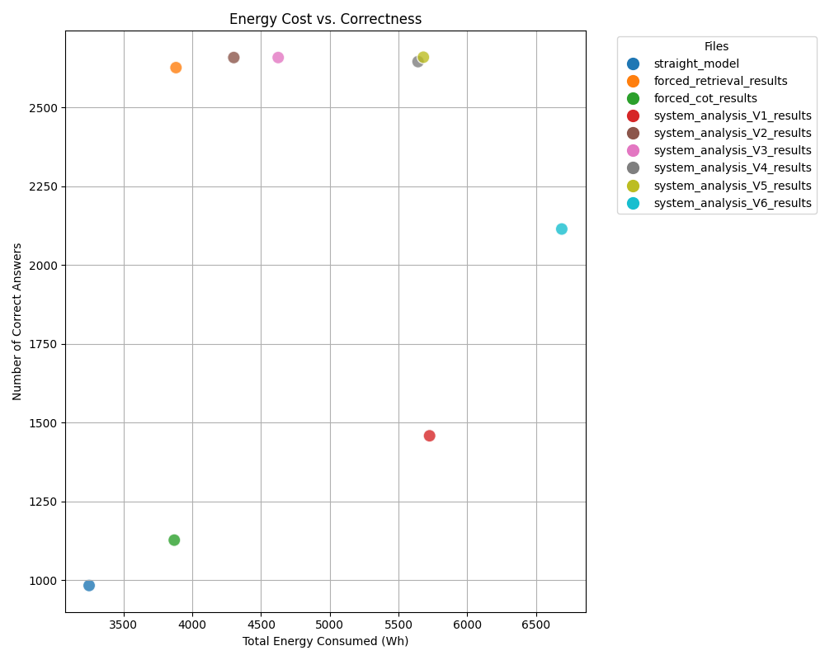
Scatter plot Energy Cost vs. Correctness
The scatter plot shows a clear trade-off between energy consumption and correctness more accurate outputs usually require more energy.
Baseline models cluster in the lower-left: low energy, low correctness.
One baseline looks better than expected, but this is misleading due to Wikipedia retrievals being somewhat relevant to the ARC-easy.
Optimized systems move toward the upper-right: higher correctness and better quality, with increased energy use.
System Analysis V1 is an outlier inefficient instructions caused high energy use but poor accuracy.
Notes:
Now looking at the result we clearly see that the system works as designed

Slide 20
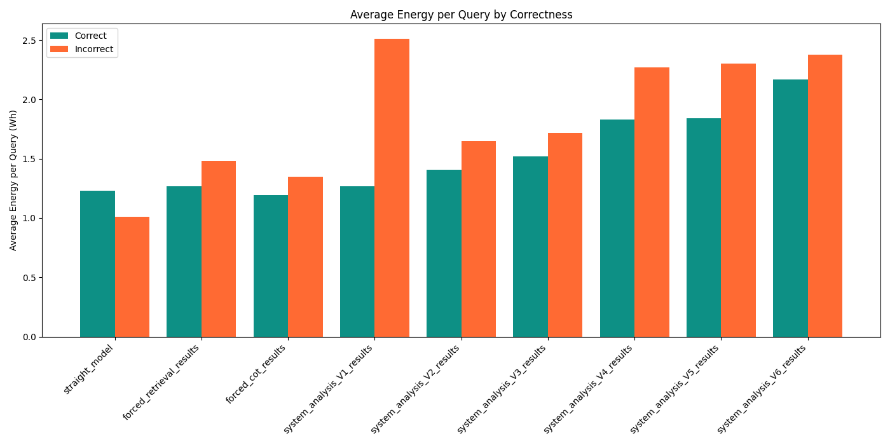
Average Energy vs Correctness
Incorrect answer almost always are more energy dependent than correct ones
This is especially true for latter instructions.
The straight model is the only version that this is not true.

Slide 21
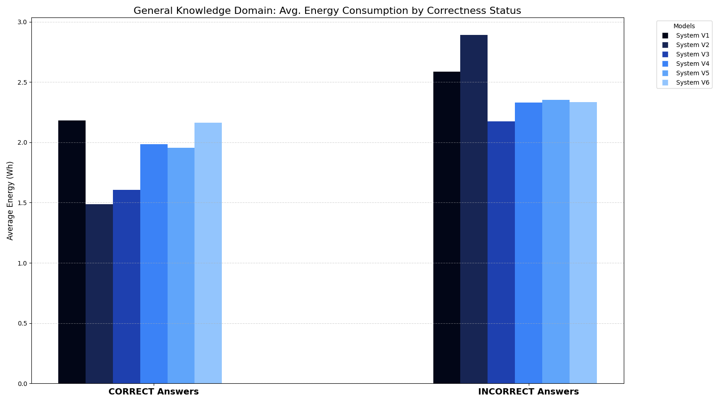
Energy consumption on HotPotQA

Slide 22



Key Findings & Results
Performance Achievements (Contribution C4)
56%+
Answer Accuracy on ARC
Against the original model.
<50%
Energy Consumption
Compared to 14B baseline, without sacrificing accuracy.
Routing Efficiency
Profile-based prompts optimize query distribution across DA, CoT, and RAG paths, improving balance.
Energy Insights
Accuracy directly correlates with efficiency, as incorrect answers consume more energy.
Performance Gap
Architectural control and prompt engineering narrows the performance gap to larger models.
Bottom Line
The adaptive routing framework enables SLMs to deliver enterprise-grade accuracy using <50% of the energy of larger models, making AI viable for resource-constrained organizations.

Slide 23
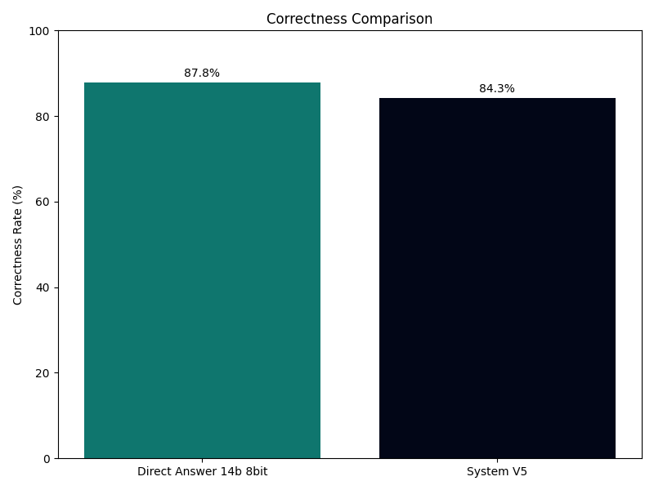
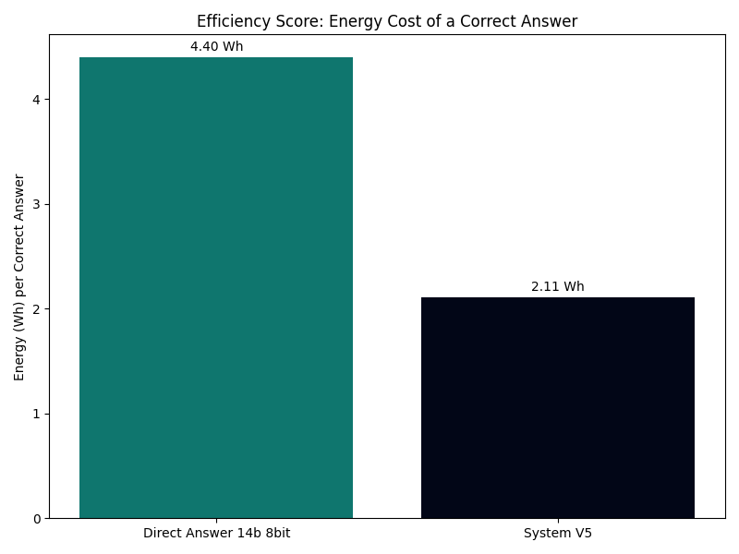
Routing system vs Bigger model
Arc(easy)

Slide 24

Artifacts & Reproducibility
Research Outputs for Community (Contribution C5)
Provided Artifacts
Instruction Templates
For DA, CoT, and RAG query variations
Routing Controller
Complete architecture and logic specification
Voting Post-Processor
Ensemble decision mechanism design
Analysis Components
Route Choice Ablations
Performance analysis of routing decisions
Instruction Design Ablations
Impact of prompt engineering variations
Reproducibility Guides
Step-by-step replication documentation
Reproducibility Commitment
Complete transparency in methods and results Detailed documentation for all components Publicly accessible artifacts to foster extension
QR Code

Slide 25


Summary & Future Work
Enabling Practical AI Deployment
Key Contributions
Adaptive Query-Routing
Intelligent per-query selection between DA, CoT, and RAG paths.
Future Work
Multi-Model Ensemble Routing
Extend framework to route between multiple specialized models.
Learning-to-Route Strategy
Iterative prompt refinement from heuristics to profile-based classification.
Real-Time Adaptation
Implement online learning for continuous routing optimization.
Performance Achievements
Achieved 85%+ accuracy with under 50% energy consumption of baseline.
Ultra-Low Resource Deployment
Investigate using a compact model for routing, reserving the primary, larger model for generating the response.
Community Artifacts
Full reproducibility package with templates and analysis.
Broader Impact
Democratizes AI deployment for SMEs
Enables privacy-compliant on-premises solutions Reduces environmental footprint of AI systems
Intelligent system design can make advanced AI accessible, efficient, and practical for resource-constrained environments.
A pathway toward democratized, sustainable AI deployment

Slide 26
Thank You

